Slide 1
SCUSA Strategic Plan 2016 (P-19)
3-year Business Strategy and Financial Projections
6.15.2016

Slide 2
AGENDA
Executive Summary 3
Economic Outlook 6
Key Assumptions 9
Financials 18
Appendix
Risks & Opportunities 26
Appendix 29

Slide 3
Executive Summary
Macroeconomic & U.S. Auto Scenario
Stable US economy with GDP growing at 2% over the next 4 years
Steep yield curve with rate increase and prime reaching 3.5% by 2018 and flattening yield curve
U.S. auto market growth expectation tapering to 1-1.5% over the forecast horizon, derived by maturity of auto sales post 2008 recession
Key Assumptions
Originations down 2016 vs 2015 by 13% due to credit actions and implementation of FTP. Future growth in line with GDP and industry expectations
Chrysler penetration rate stable at ~26% and not expected to increase and lower than P-18
Credit spread maintained at current levels seem in recent SDART and Drive transactions. Unsecured issuance at 350 bps spread with warehouse spreads increasing 30 bps on renewals
US Bank lease partnership anticipated in September with flow increasing from 20% to 40% - below 80% maximum to ensure LKE benefit is maintained
Puerto Rico initiative awaiting final tax opinions and anticipated to be fully launch in August 2016 - $70mm tax benefit in 2016 eventually increasing to $160mm once fully executed on 100% of the performing portfolio
Financial Performance
2016 net income of $700mm (unfavorable to budget) driven by higher losses and no gain on CCART and asset sales execution partially offset by larger balance sheet and lower compensation expense
Net incomes in P-19 at lower levels than P-18, primarily due to lower yields (growth of prime assets and yield compression with rising rates), lower gains on assets sales and lower size of serviced-for-others book. NIM impact is materially offset by lower losses and lower provisioning
P-19 net income growth challenged by exit of personal lending business, lower investment gains and yield compression
ALLL coverage ratio of 12.4% in 2018, 50bps higher than P-18 but net losses favorable
Key Sensitivities
Rate forecast & credit spreads
Provision build and loss forecast
Chrysler penetration
Secondary market and asset sale economics
*Puerto Rico initiative – Diversify and relocate portfolio servicing to a new subsidiary based in the lower tax jurisdiction of Puerto Rico

Slide 4
P-19 Key Performance Indicators
2016 to 2019 net income in the range of $700 – 775mm, including Puerto Rico tax benefit. Decline in core net income primarily driven by lower serviced assets, lower gain-on-sale on asset sales & lower yield expectations
Owned average earning assets in line with P-18 forecast but mix shifting towards higher prime loans (10% weighting vs. 6% in P-18)
Serviced assets at 50% of P-18 driven by lower originations & maintaining (not increasing) current Chrysler penetration levels
Dividends reinstated from 3Q17 at 30% payout
*Puerto Rico initiative – Diversify and relocate portfolio servicing to a new subsidiary based in the lower tax jurisdiction of Puerto Rico

Slide 5
AGENDA
Executive Summary 3
Economic Outlook 6
Key Assumptions 9
Financials 18
Appendix
Risks & Opportunities 26
Appendix 29

Slide 6
P-19 Macroeconomic Scenario
Forecast scenarios for key macro themes impacting the U.S. auto market
Moderate economic expansion through 2019 without material surprises up or down
Sustained low unemployment, leveling off of at full employment by 2019 – 5% unemployment rate
Average inflation (2.1% CAGR)
Households continue to engage in more precautionary saving and therefore cautious spending
U.S. auto market growth to slow (<2%) after multiple years of strong growth
Steady inflation, low unemployment and moderate GDP growth leads to orderly rise in short-term rates and flattening yield curve
Material yield curve flattening by 2019
Sources: U.S. Board of Governors of the Federal Reserve System (FRB); U.S. Bureau of Labor Statistics (BLS): Current Population Survey (CPS); Moody's Analytics Forecasted

Slide 7
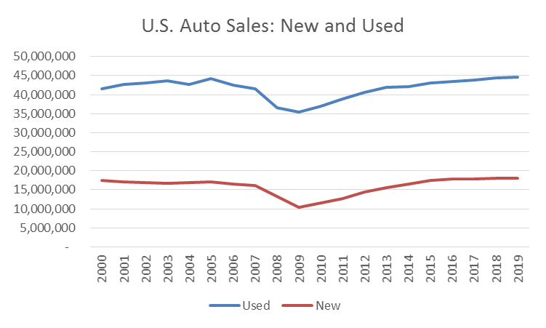
P-19 U.S. Auto Market Forecast
New Sales Forecast
New car sales forecasted to be flat to marginal growth after 2016 having followed a period of accelerated growth
New auto sales forecasted to be strong from tax season for about 6 months and slow growth in late fall consistent with past seasonality experience
Used Sales Forecast
Used car sales forecasted to slow growth for a couple of years similar to new car sales
Used market will see growth albeit at a slower pace. With declining used car pricing and higher available inventory – segment is forecasted to have slower growth in dollar terms
Used auto sales forecasted to seasonally peak in June/July
Source: CNW Research for historicals; LMCA and multiple websites for forecast periods

Slide 8
AGENDA
Executive Summary 3
Economic Outlook 6
Key Assumptions 9
Financials 18
Appendix
Risks & Opportunities 26
Appendix 29

Slide 9
P-19 Origination Forecast
$25.2B total originations in 2016, increasing gradually to $27.6B by 2019. Prime and Lease expected to grow faster than Core and NonPrime. Lower than P-18 primary driven by lower forecasted Chrysler penetration rates.
Origination growth (in dollar terms) consistent with market and slightly higher growth in CC Prime and Lease
Dollar originations to grow overall at 3.2% in next 3 years.
With 1% inflation in car prices, overall unit growth in 2-3% range.
Core and CC Non-Prime to grow at 2%, in line with market
Prime and Lease to grow faster at 3% in unit terms.

Slide 10
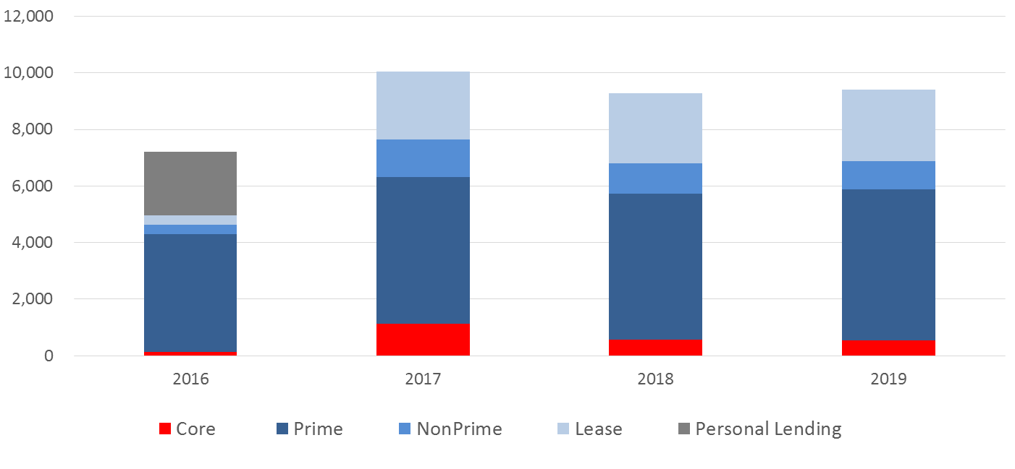
P-19 Asset Sales Forecast
Flow and portfolio sales grow from $7.3B to $9.4B with no gain or loss on sale. Growth primarily driven by US Bank lease agreement.
($MM)
Bluestem sale as of Oct 1st. Proceeds consistent with anticipated discount
$300mm commercial pool sold in Aug-16 with no gain or loss
Flow sales continue with BANA and Citizens flow sales end early 2017
All CCARTs structured in 2016 to be classified as HFS, and sold within 6-9 months. Starting 2017, markets assumed to recover and residuals to be sold simultaneously to achieve off-balance sheet treatment
Discussions ongoing with SBNA for flow as well as residual sale, but not incorporated in P19 Round 1
US Bank lease sale starts at 20% of production in Sep-16, and ramps up to 40% by Jan-17. SC fee assumption of 50bps on US Bank flow

Slide 11
P-19 Owned & Serviced Assets vs. P-18
Owned auto loans portfolio steady in 2017 primarily driven by lower yielding prime loans
7.5% of assets to 10.5% of assets over P19 horizon (vs. P-18 at 4.3% in 2018)
Negligible growth in non-prime assets (1%)
$4B lower non-prime balance
Lease portfolio at $9.4B by Dec-16, and steadily reaches $6.5bn by 2019 as US Bank absorbs 40% of production
Serviced for others book to grow moderately at $0.6 to $1.0bn every year or 6% - Well below P-18 levels

Slide 12
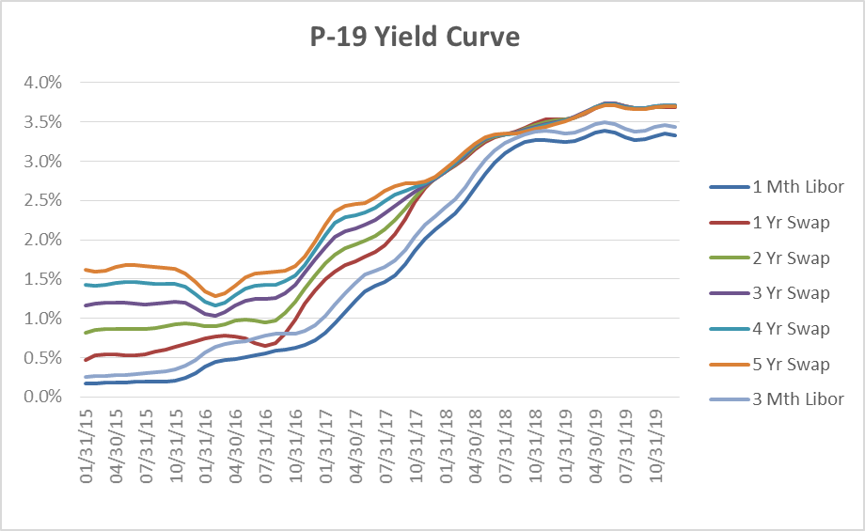
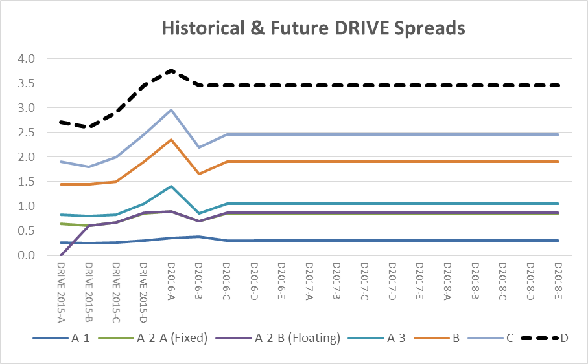
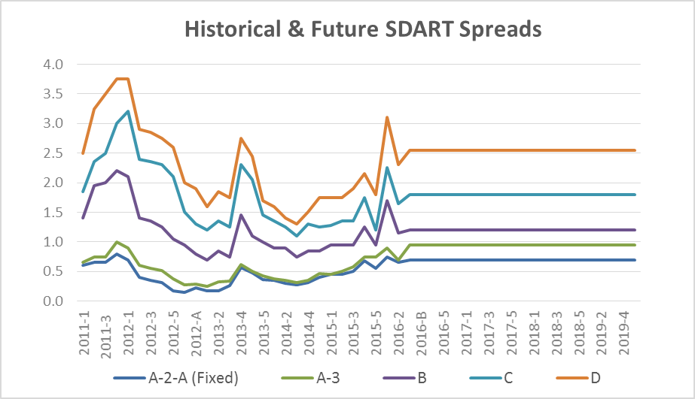
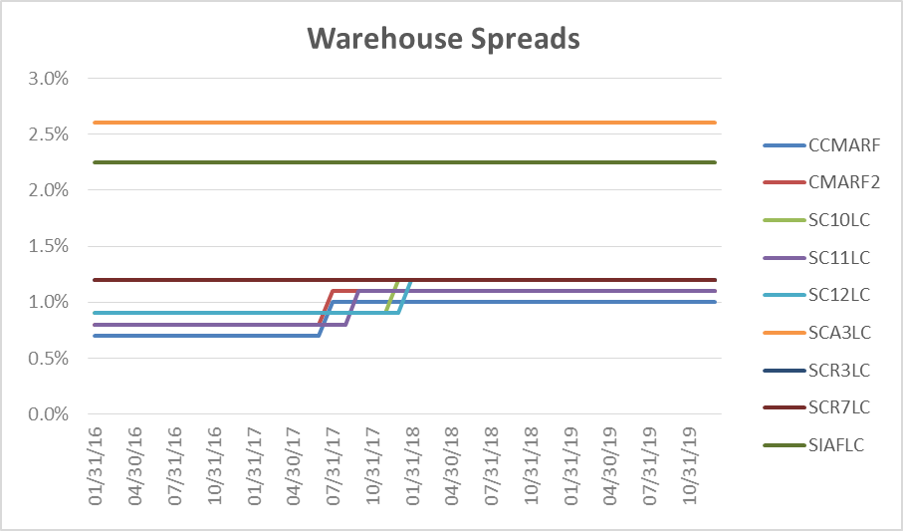
P-19 Yield Curve & Credit Spread Assumptions
Orderly increase in rates (3 month LIBOR at 3.5% at end of 2019), with longer term spreads across tenors narrowing
For future deals, spreads prevailing in Sep/Oct-15 assumed that were somewhat higher than the May-16 transactions but lower than Q1 2016
Warehouse on loans and CCMARF price at 30bps higher spreads on renewal

Slide 13
P-19 Funding Plan & Cost of Fund
$1.3B unsecured debt issuance by Dec-16, to increase to $3.3B in 2017 and stay flat at that level
Unsecured issuance to cost incremental 150bps
About $10-14B in yearly new issuances through ABS and amortizers consistent with prior years
Interest cost by facility to increase as yield curve rises
Liquidity buffer incorporated $35mm vs $70mm for P-18

Slide 14
P-19 Yields
New originations yields in line with rate increase but portfolio yields will lag
Funding pass-through based on 2-year swap rates at 75% transfer to customer on Core, CC NonPrime and CC Lease, and 85% for CC Prime
Portfolio yield increasing by 15-70 bps based on channel
Dealer participation audit and compliance findings captured at $14mm in 2016, $46mm in 2017 and growing to $70mm

Slide 15
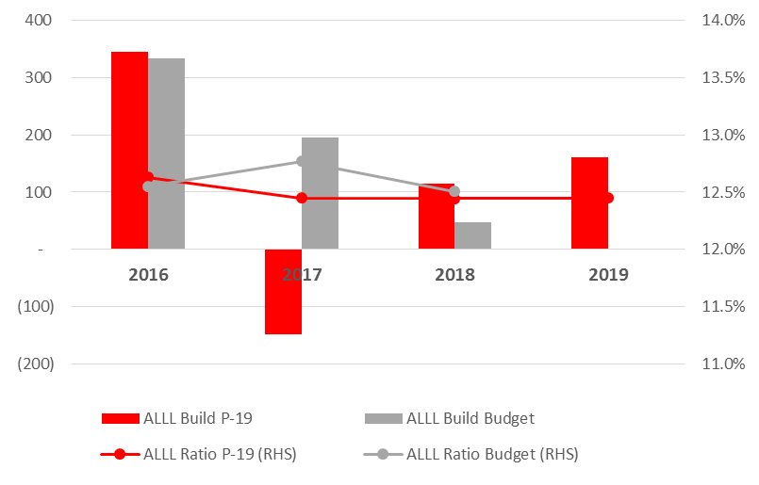
P-19 Net Credit Losses & Loan Loss Reserves
Net credit losses rise slightly in 2017 and decline in subsequent periods but favorable to P-18
ALLL ratio at 12.6% in April-16, to remain close to 12.5% in 2017 but unfavorable to P-18
Gross Charge-Off ratio on Core between 15%-17% for 2016. For 2017/18, ratio to decline as 2015 vintages mature. See Appendix for Gross Charge-Off ratio.

Slide 16
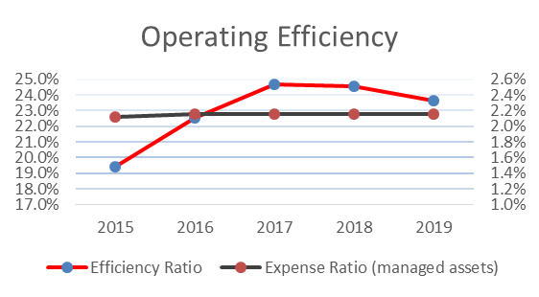
P-19 Operating Expenses
Expense ratio of 2.2% in 2016, and remaining at 2.2% in future years.
Flat expense to managed assets ratio as investments in VIP program, additional BOD legal costs, finance systems, compliance, cyber-security and material weakness captured appropriately and offset by expense management efforts
Expenses reflect SC achieving target expense reductions of $53mm and $71mm
Loan Servicing area only expenses based on drivers
3% inflationary on personal costs incorporated
Higher repo costs also captured reflecting higher loss expectations – tail off in second half of 2017

Slide 17
AGENDA
Executive Summary 3
Economic Outlook 6
Key Assumptions 9
Financials 18
Appendix
Risks & Opportunities 26
Appendix 29

Slide 18
P-19 2016 Quarterly Outlook
Full year results negatively impacted by seasonally higher credit losses and lower gains from CCART and asset sales. Net income of $700mm vs. budget of $775mm.

Slide 19
P-19 Income Statement (2016 – 2019)
Net incomes in P-19 at lower levels than P-18, primarily due to lower yields (growth of prime assets and yield compression with rising rates), lower gains on assets sales and lower size of serviced-for-others book. NIM impact is materially offset by lower losses and lower provisioning.

Slide 20
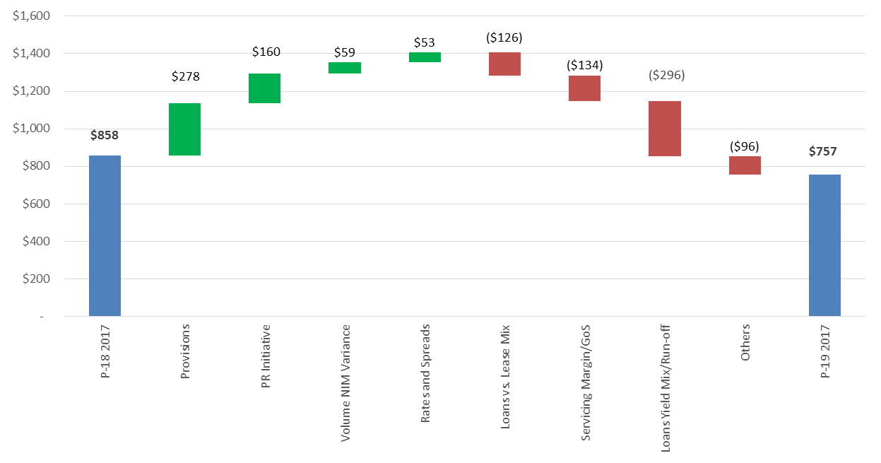
2017 P-19 vs. P-18 Walk

Slide 21
P-19 Income Statement – YoY
P-19 net income shows declining income due to continued yield compression in a rising rate environment, declining fee income (sale of personal lending business) and lower investment gains.

Slide 22
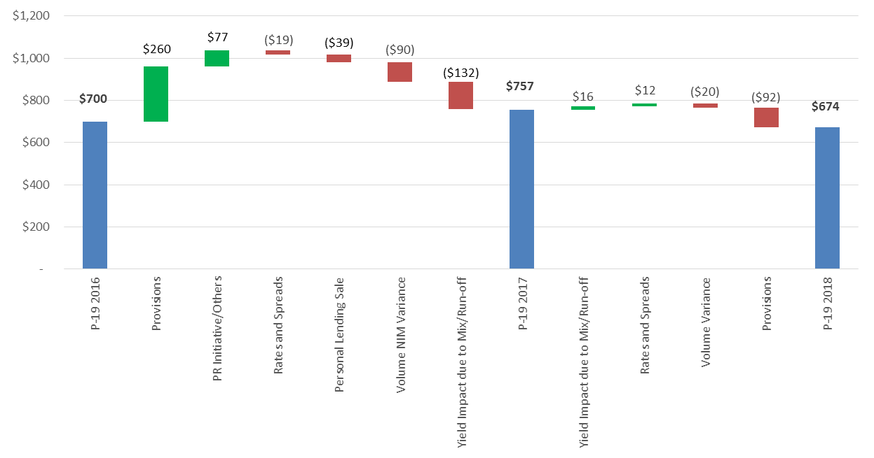
P-19 YoY Walk (2016 – 2018)

Slide 23
P-19 Key Stats – YoY
*Puerto Rico initiative – Diversify and relocate portfolio servicing to a new subsidiary based in the lower tax jurisdiction of Puerto Rico

Slide 24
P-19 Balance Sheet

Slide 25
AGENDA
Executive Summary 3
Economic Outlook 6
Key Assumptions 9
Financials 18
Appendix
Risks & Opportunities 26
Appendix 29

Slide 26
Key Sensitivities

Slide 27
P-19 Risks & Opportunities
Risks
Gross origination volumes
Puerto Rico tax opinions and execution risk
BlueStem discount on sale
Pricing on flow volume and CCART transactions
Used car prices & impact on recoveries
Unassailability initiatives
Accounting restatement and policy alignment
Dealer discount accretion (max exposure $240mm)
TDR discount rate ($50-115mm)
Treatment of partial payments and return to accrual ($100mm)
Opportunities
Ability to address risk margin pressures on new originations
Rate increase is slower than forecasted
Losses & ALLL Coverage ratio

Slide 28
AGENDA
Executive Summary 3
Economic Outlook 6
Key Assumptions 9
Financials 18
Appendix
Risks & Opportunities 26
Appendix 29

Slide 29
P-19 Income Statement (PPNR View)

Slide 30
P-19 Gross Credit Losses

Slide 31
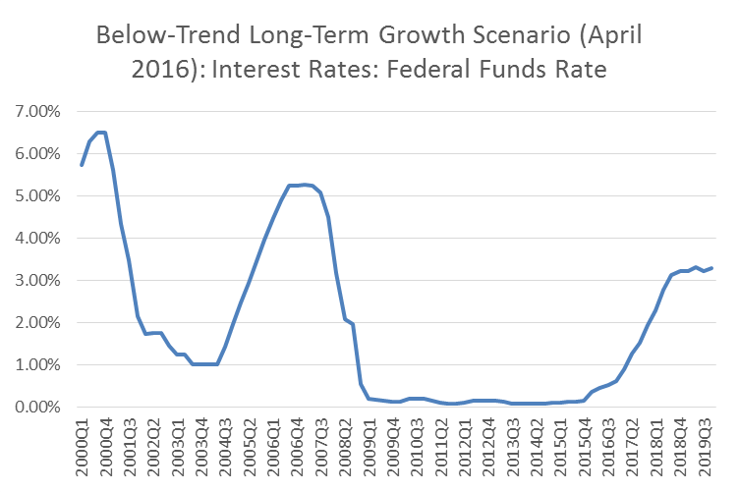
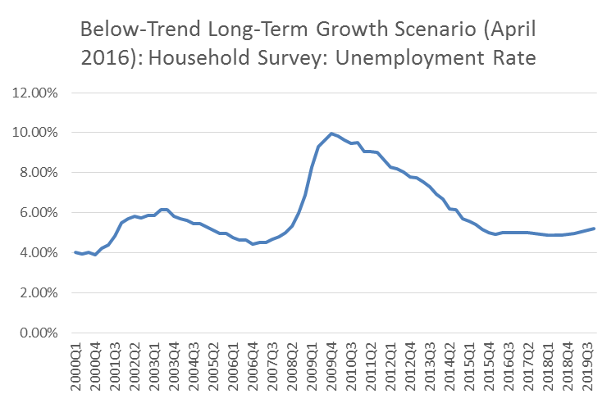
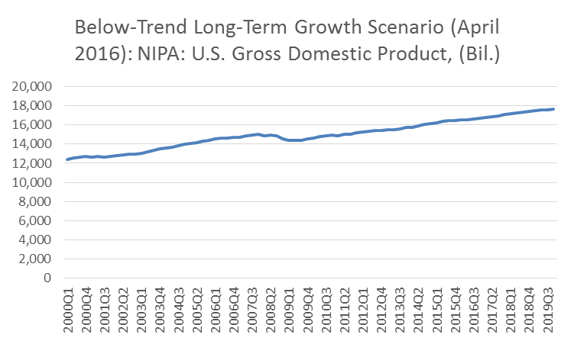
P-19 Monetary & Fiscal Policy – Key Themes
Federal Funds Rate
Fed remains cautious in normalizing interest rates. Signaled the next rate hike will not occur until the June meeting.
Rate normalization will be a lengthy process. If the economy performs consistently with the Moody’s Analytics outlook, short-term interest rates will not normalize until the second half 2018.
Most significant headwind impacting fed funds rate is the higher required capitalization and liquidity of the post-crisis banking system. In order for the system to extend further credit to the economy, banks’ lending margins must be maintained, aided by the Fed adopting a lower equilibrium rate and thus lowering bank’s cost of funds
Expect steady and orderly rise in long-term rates with 3.5% Fed Funds rate by end of 2019.
Employment
Economy close to full employment and has recovered to similar levels seen pre-financial crisis.
Rate of employment growth forecasted to be slightly below the forecasted rate of inflation.
Unemployment rate expected to remain in the vicinity of 5% over the next several years
Federal Budget & GDP
Federal government’s situation is stable following a budget deal that sets tax and spending policy into early 2017.
Given the budget deal, fiscal policy will be a small positive for growth in 2016, adding ~0.2 percentage points to real GDP growth.
Nation’s debt-to-GDP ratio stabilizes, at least through the remainder of the decade, which is expected to be enough to satisfy financial markets and allow the recovery to gain traction.
Real GDP growth is lower than the baseline forecast.
On an annual basis, real GDP forecasted to increase 1.3% in 2016 and 1.9% in 2017.
Sources: U.S. Board of Governors of the Federal Reserve System (FRB); U.S. Bureau of Labor Statistics (BLS): Current Population Survey (CPS); U.S Bureau of Economic Analysis (BEA); Moody's Analytics Forecasted

Slide 32
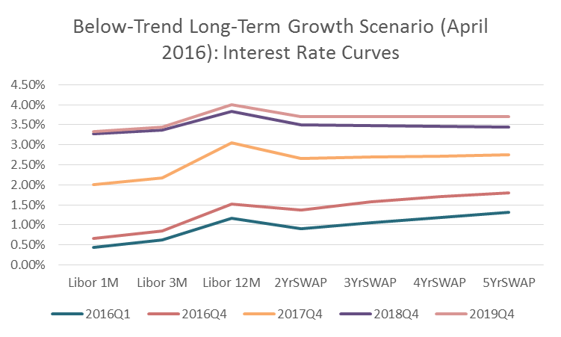
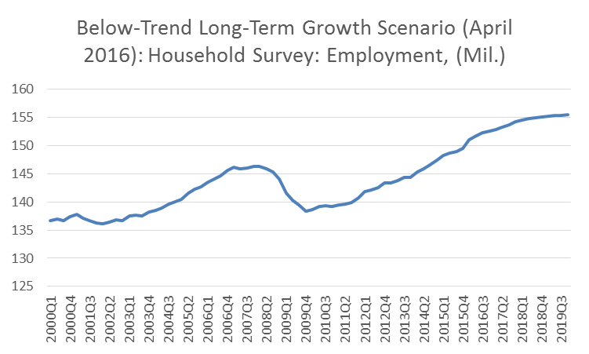
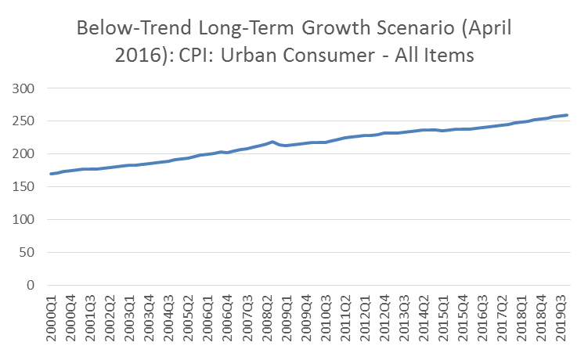
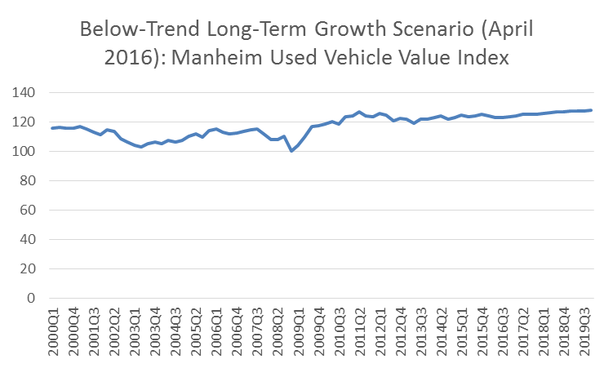
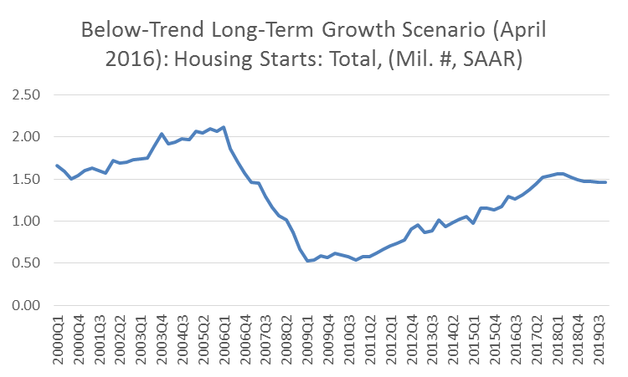
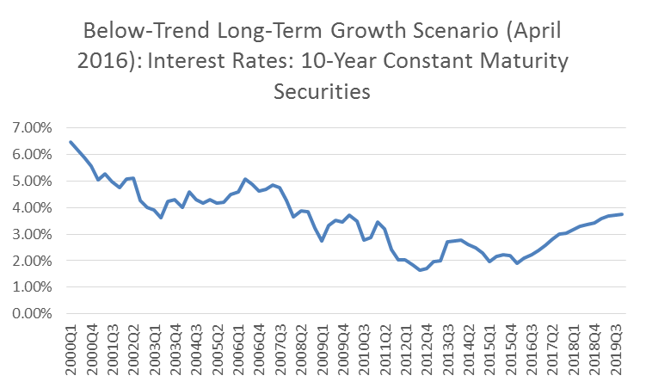
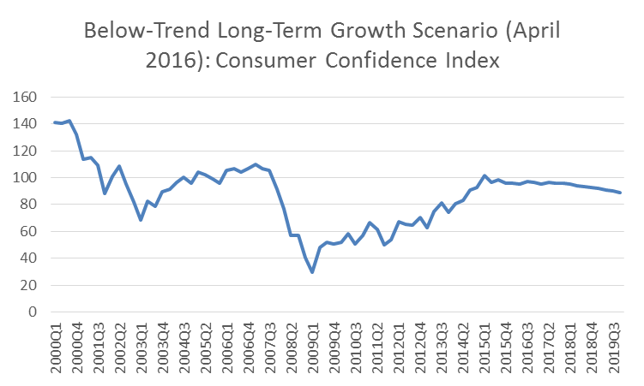
P-19 Economic Metric Trends
Sources: The Conference Board; U.S. Bureau of Labor Statistics (BLS): Current Population Survey (CPS); U.S. Bureau of Economic Analysis (BEA); Manheim Consulting; U.S. Board of Governors of the Federal Reserve System (FRB); U.S. Census Bureau (BOC); Moody's Analytics Forecasted

Slide 33
P-19 Risk Appetite Statement Metrics
SC to be in compliance most binding RAS metrics including 12 month rolling charge-off rate, CET1 ratio and RWA
Net charge off and allowance for loan losses being reviewed by Credit
Benchmark limits for 2016 being reviewed and to be reset based on new scenarios from CCAR 2016 results
2nd line of defense review and signoff would be conducted prior to the Round 2 submission of P-19 – feedback would be incorporated prior to BOD approval

